Slide 1
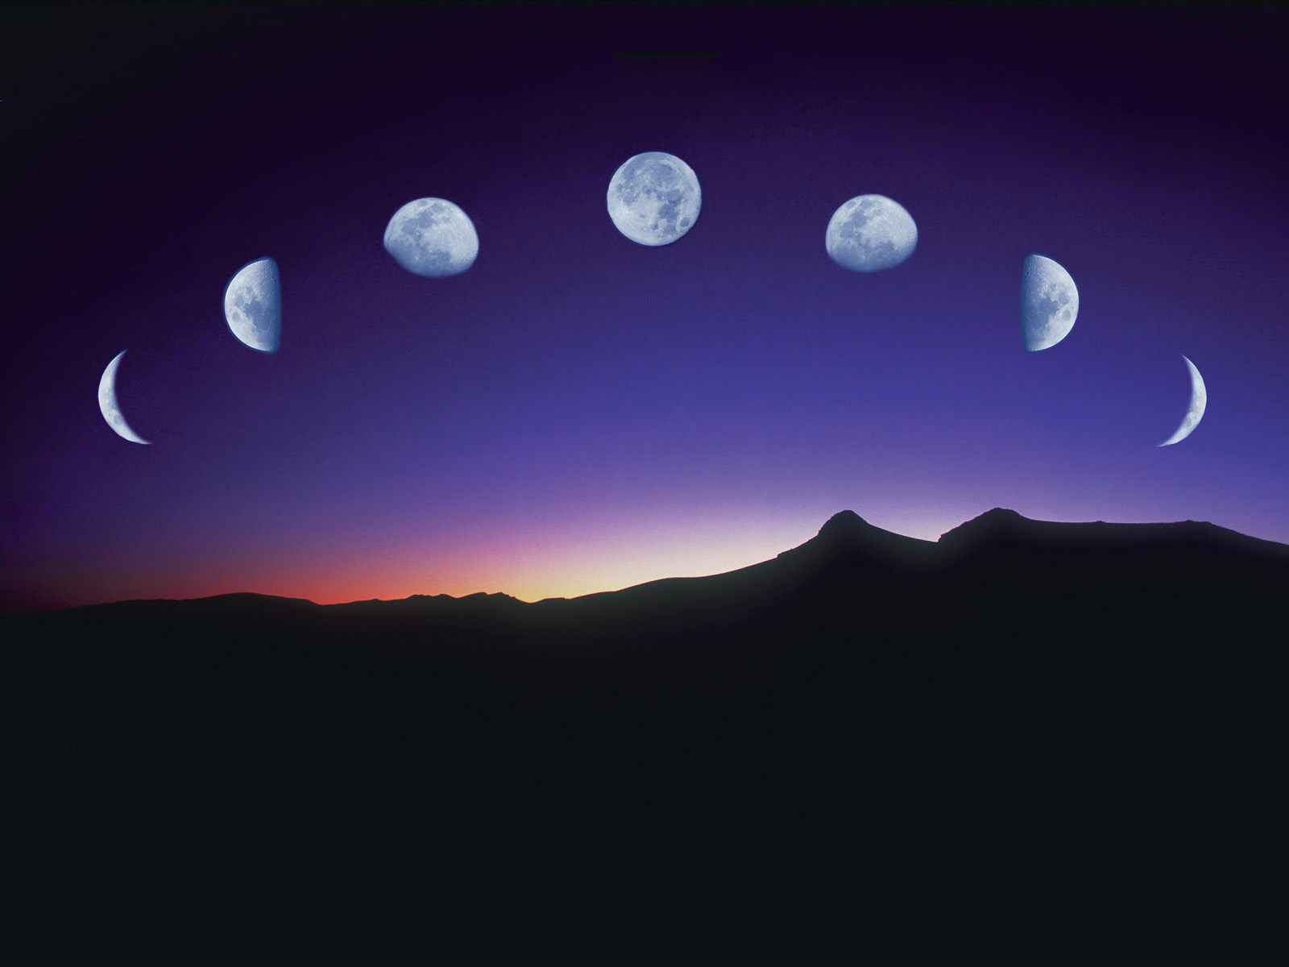
The Cycles of the Moon
Astro Pages 22-23
Earth and Space Science

Slide 2
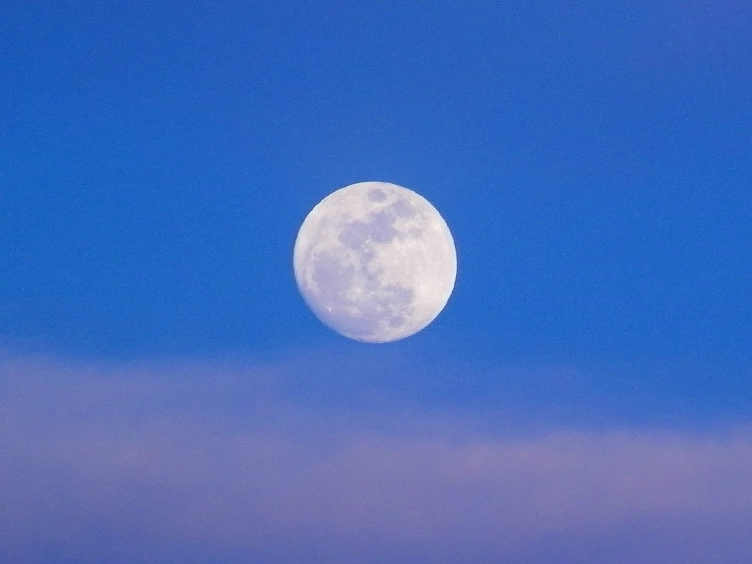
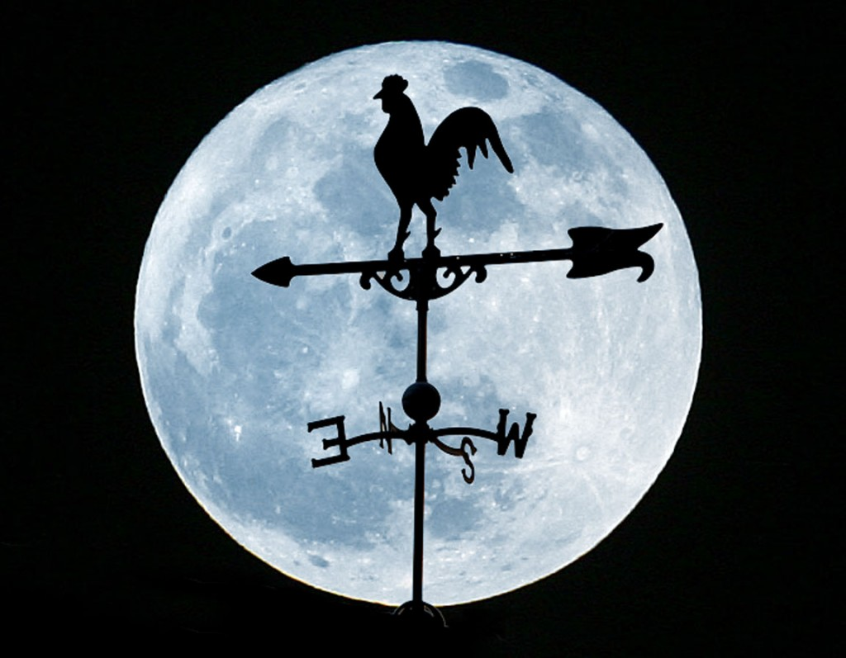
The moon orbits eastward around the Earth once each month.
You should be able to see the moon in the sky at night and sometimes during the day.

Slide 3
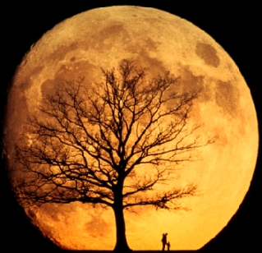
If you observe the moon nightly for a month you will be able to see how its appearance changes as it goes through what are called phases.
In our lab, we will learn more about the moon’s phases.

Slide 4
The Motion of the Moon
There are two things you should notice about the moon if you observe it nightly.
1. You will see it move across the sky
relative to the background stars.

Slide 5
You can witness this simply by looking once
every 10 minutes, and see that it has changed
location in the sky. In the span of one hour the
moon will move across the sky in a distance
equal to its apparent diameter.

Slide 6
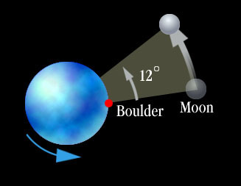
You can also check at the same time each night
and see that it is in a different location nightly at
the same time. The moon will be about 12-13º
eastward from the previous night’s location.

Slide 7
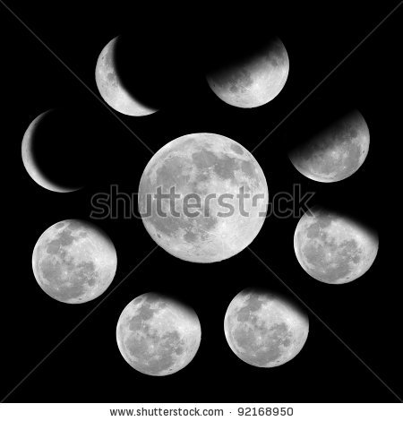
2. You should note that the markings on the face of
the moon do not change from observation to
observation.

Slide 8
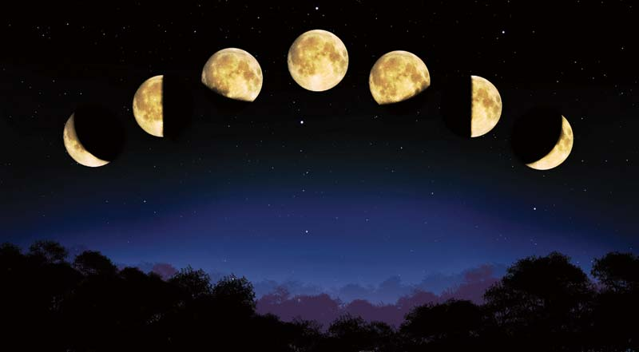
The Cycle of Moon Phases
One of the most easily observable astronomical phenomena is the changing shape of the illuminated part of the moon as it orbits Earth.

Slide 9
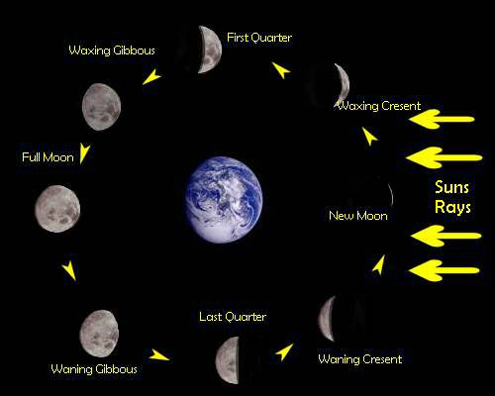
From full moon to a thin crescent moon, the “lit-up” part changes shape dramatically during the course of a one month cycle.

Slide 10
There are three important concepts to keep in mind, when studying the phases of the moon.
The moon always keeps the same side facing
the Earth. This means an observer from
Earth will never see the far side of the moon.

Slide 11
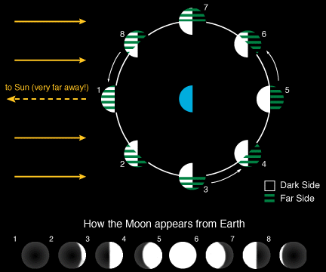
2. The changing shape of the moon as it passes
through its cycle of phases is produced by
sunlight illuminating different parts of the side
visible to us.
Basically the
shadowed area
keeps changing
from our
perspective.

Slide 12
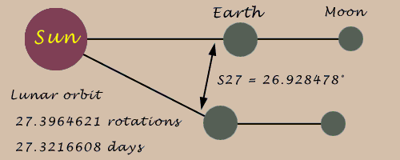
3. The orbital period of the moon around the Earth
is not the same as the length of the moon
phase cycle.

